Slide 1
Our Recovery Curriculum’

Slide 2
Why a ‘Recovery Curriculum’?
“The children will be so far behind academically when they return.” We constantly hear this refrain from the government and in the press. This is incompatible with the process of recovery from loss, trauma, anxiety and grief. It is more about the results culture that so many schools, and society in general, are steeped in.
We have an opportunity now to develop new ways, which put the child, his/her overall well-being and secure development at the center of education. Without this, academic results can have no authentic meaning or personal value to the child going forward into the world of secondary school, adulthood and work.

Slide 3
Why a ‘Recovery Curriculum’?
The primary focus of schools at this time should be to embark on a long, sometimes challenging, journey with each individual child, through a process of re-engagement, reconnection, which guides and supports them back to being ready to learn, able to settle to learn and fully engaged with learning.
This, I believe, means that we focus on relationships, play, therapy/healing, and compassion.

Slide 4
The Four Levels of Need
Relationships; Therapy approach; Compassion; Play, Play, Play!

Slide 5
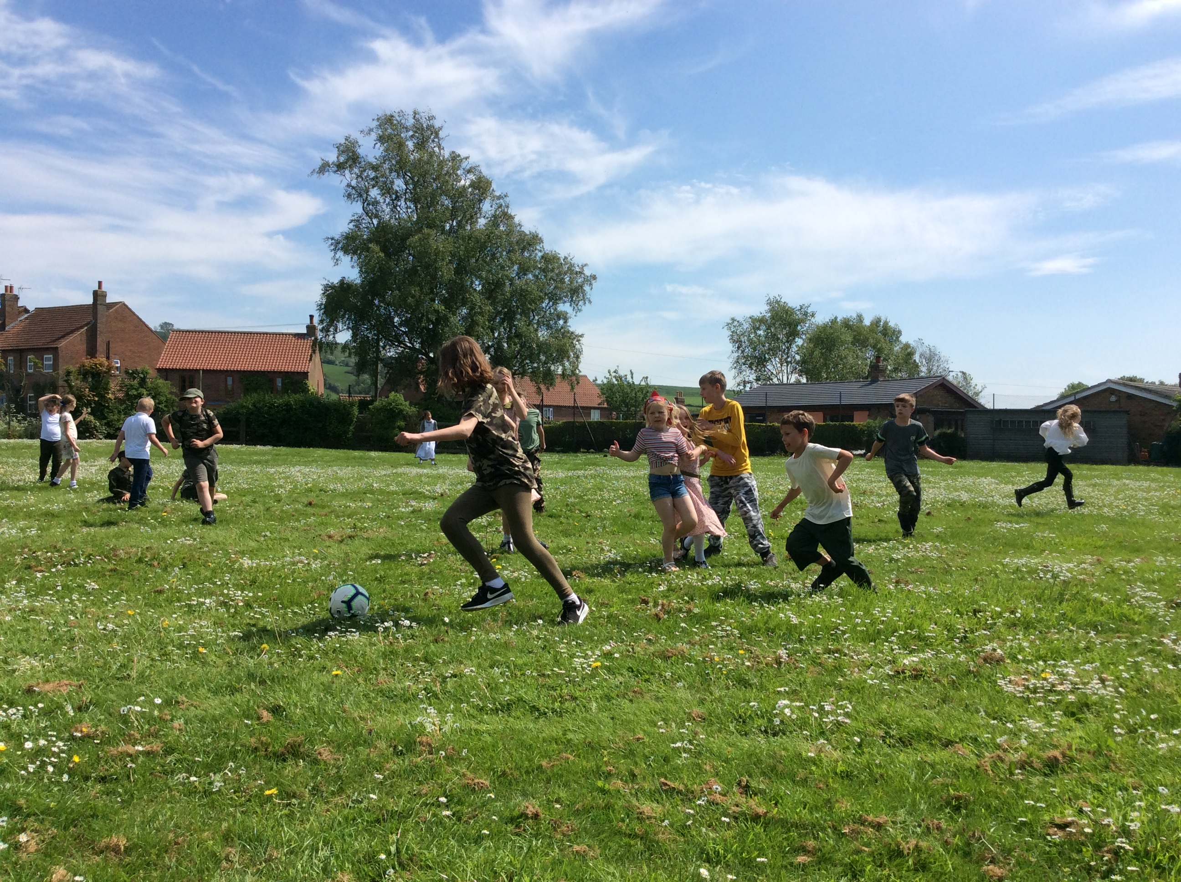
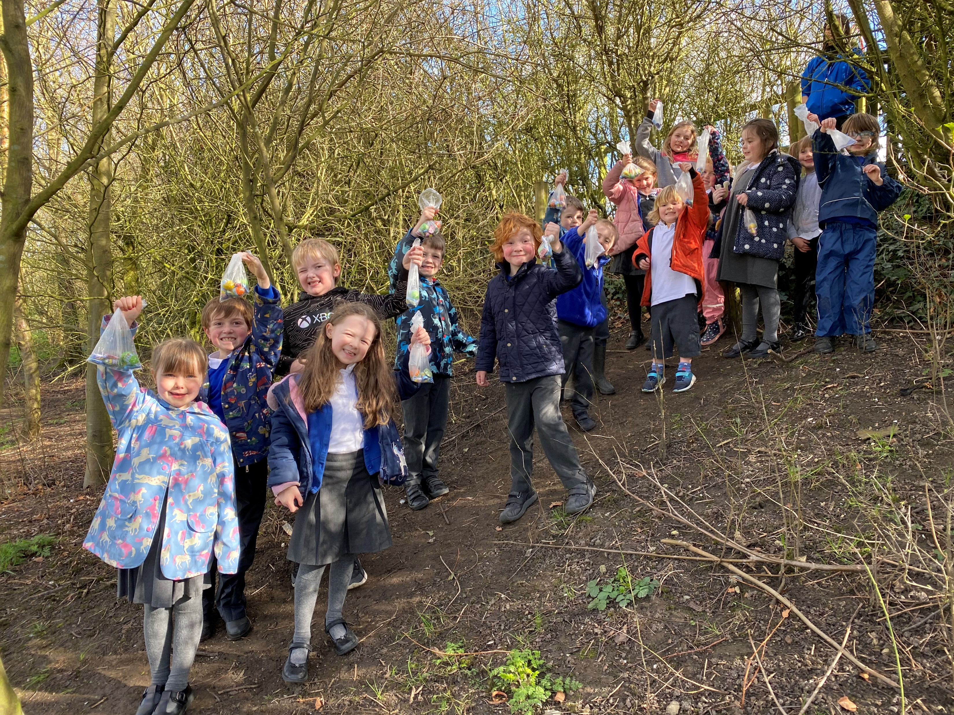
A Relational Curriculum

Slide 6
Relationships
Relationships have really taken a beating during the pandemic, both at home and at school.
Many children will not have interacted with extended family, friends, peers or educators for many weeks, and this loss of three dimensional contact will, for many, have caused issues around attachment at home and in school.
For some children their school relationships may be the strongest and safest relationships they have.
Lack of connection with these safe people will have lead to feelings of disconnection, abandonment, and even feelings of doubt that previously trusted adults are unable to keep them safe. Thus, attachments may have become fragile and tenuous.

Slide 7
Meet and greet
Necessary every morning for every child to create feelings of safety and security.
Establishes connection at the start of the day.
Should be boundaried, with the adult giving full attention to the child.

Slide 8
Structure, routine AND flexibility
Decisions based on the needs of the child rather than the needs of the timetable, OFSTED, curriculum, opinions of other staff, other parents, other children.

Slide 9
Therapeutic
Trauma always falls hardest on still-developing children. The notion that they are naturally resilient is supported by zero research evidence.
Becoming a therapeutic environment does not require the transformation of classrooms into CAMHS clinics or educators into psychotherapists.
It means that we take seriously the notion that every interaction and experience has the potential to be healing or damaging, and actively choosing the former.

Slide 10
Being authentic, curious and connected
In order to be therapeutic communities, for every member of staff, including non-teaching staff, training on attachment and trauma sensitive practice will be essential.
Practitioners need to understand the difference they can make by simply being available and by being kind.
Remember, every interaction is an intervention; every intervention has the potential to be therapeutic.
Therapy is not restricted to things we do, it’s mainly transmitted by how we are.
The being authentic, curious and connected approach is powerful therapy to support those affected by trauma, and that is the whole school community.

Slide 11
Play-based
Play is a language for children; it’s how they process information and experiences.
Part of the play process is projection. When a child is overwhelmed or troubled or confused by something in their internal experience, e.g. loneliness, isolation, fear, they use toys, art, role play, imagination etc. to express their feelings.

Slide 12
High-quality play opportunities
So children of all ages and stages need to be given access to high-quality play opportunities on their return to school.
This should be prioritised aver academic learning as it will be essential to help relieve stress and anxiety among children, and help them to process what has happened to them during this time.
Research shows that high quality play opportunities post-pandemic for children who experienced quarantine or social isolation were a protective factor and reduced negative outcomes for later mental health.

Slide 13
Outdoor play and learning to reconnect brain pathways
20 minutes in a green space is as effective in calming the brain as a dose of Ritalin, so get them outdoors, whatever the weather!

Slide 14
A Multiplicity of Arts and Cultural Activities
Enabling children to be …
Creators
Innovators
Collaborators
Storytellers
Engineers
Artists
Actors
Athletes
Designers
Researchers
Explorers and much more
Not only recovering, but rebounding and reigniting with energy, vigour and a celebration of talents

Slide 15
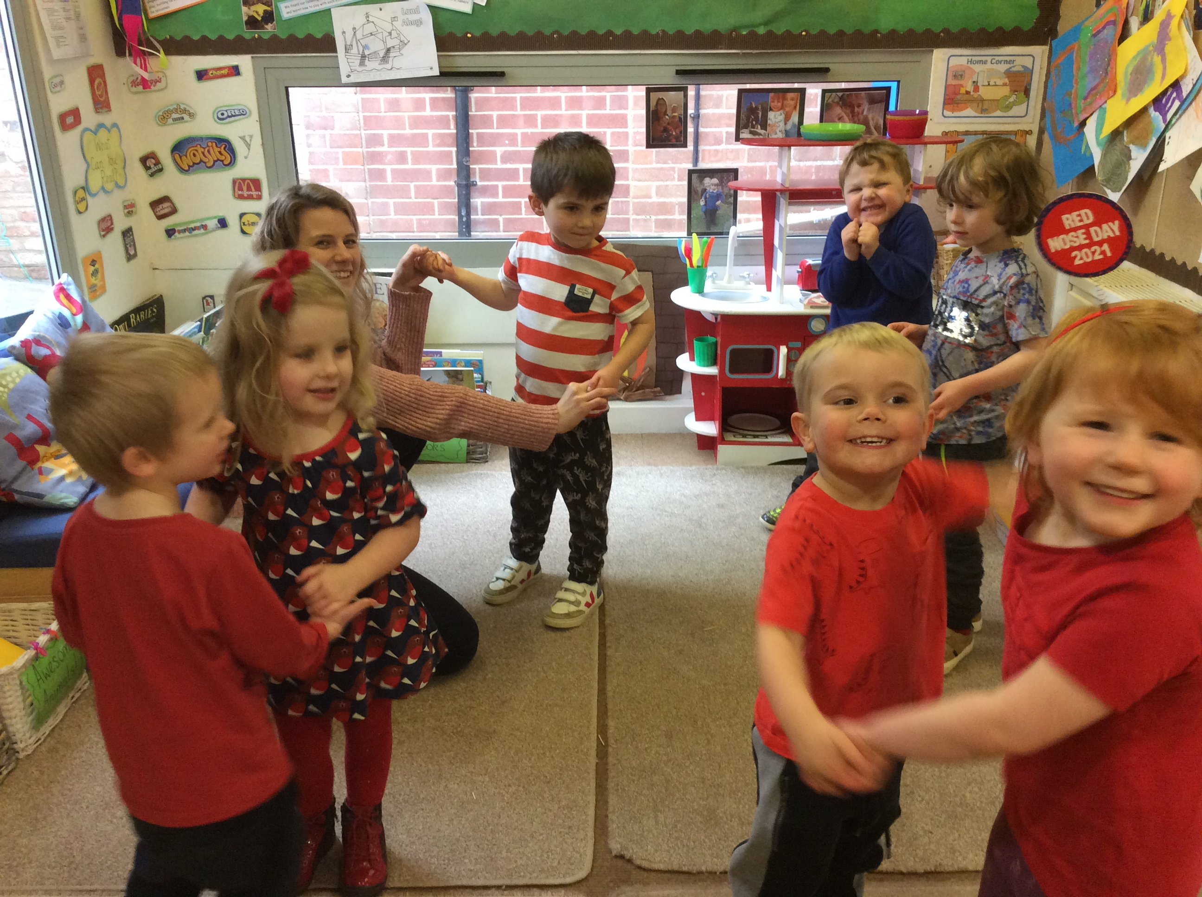
A Compassionate Curriculum

Slide 16
Loss and grief
The pandemic is triggering feelings of loss and grief both in the individual and in our communities. Most children are extremely social animals, and the loss of social groups has been distressing for many of them. This could mean Brownies, Dance Class, Football Teams, Martial Arts etc. This is a common thread in their experiences of the pandemic.
There are other losses too, for example, exams, which are rites of passage, and other rites of passage: first communion, end of term celebrations like school disco, residentials, graduations to name but a few.
All our children have lost something and they will therefore experience anxiety, trauma and grief. Our children are particularly vulnerable at this time, and their mental health is fragile.

Slide 17
Compassion: a necessity
A trauma-informed school communicates compassion in the light of all that has happened, is happening and what will happen in future.
The priority on return to school is to provide comfort, safety, and reassurance.
Schools at this time should be a haven for children and parents, not a battleground, weaponised with rules, timetables, catch-up, schedules, rewards and punishments.
More than ever before, schools will need to move away from behaviorist principles of ‘behaviour management’ and move towards relational polices that support social and emotional recovery and development.

Slide 18
Physical Activity and Physical Development at Leavening. We will implement:
Daily ‘Be Active’ sessions
High quality PE
Forest Schools
Active playtimes and lunch times
Active learning approaches across the day ( as per cognitive load theory training last term)
Quality outdoor provision for EYFS/KS1
Play opportunities for KS2 pupils- deconstruction role play area outside at playtimes.
Yoga and mindfulness sessions each week

Slide 19
Theraputic
Meet and Greet
Play
Relational
Compassionate
Not punishing pupils for regression
Relax Kids
The role of ‘us’
Making meaningful connections with each child.
Forest Schools
EYFS/KS1 play provision
KS2- active play at playtimes
Deconstructed role play/ loose part play in both EYFS/KS1 classroom and in main playground/KS2 classroom
Home learning activities to be mostly play based
Move away from behaviours and principles of ‘behaviour management’
Move towards relational policies that support emotional recovery and development.
Rewards
More opportunities for planned group work
Mixing across school again ( buddy's, eating lunch together, house challenges)
Roles and responsibilities for Oak Trees
Young leadership team

