Slide 1



Meet Your Brain
Parent Newsletter

Slide 2

About Us
myHappymind is an award winning, whole school and nursery curriculum. It teaches children preventative habits that support positive mental health, resilience and self esteem.
Taught to every child in a school from Early Years through to Year 6, myHappymind is delivered via an innovative technology platform making learning easy and fun.
All of the concepts we teach are based in science and research and grounded in Neuroscience and positive psychology.
We are passionate about supporting teacher wellbeing too and so all schools using the programme have access to a teacher wellbeing programme.
We are also proud to support parents by providing them with a free app to continue the learning at home.

Slide 3
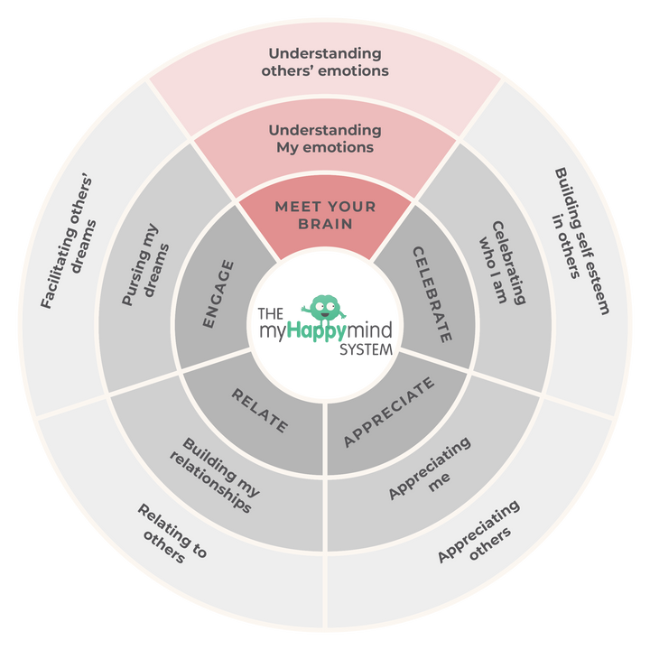
Meet Your Brain
We have just come to the end of the first module - ‘Meet Your Brain’ in the myHappymind programme.
We have learnt:
  The different parts of our brain and how they help us.
  How to use Happy Breathing to help us when we feel sad, stressed or worried.
  What happens in our brain when we learn something new and how we can look after our brain.
2

Slide 4
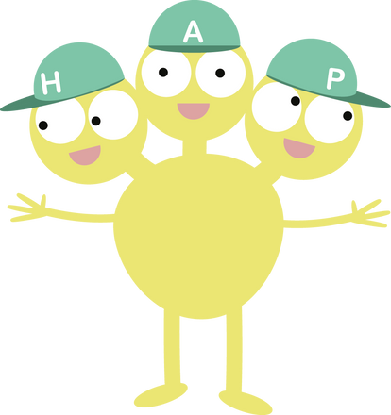
Meet Your Brain
Why not ask your children to tell you what they have learnt?
Here are some questions to help you:
Who is Team H-A-P?
Can you tell me about the Team in your brain?
Can you tell me what Neuroplasticity means?
When has your brain grown?
Why does Happy Breathing
help you and when could
you use it?
3

Slide 5
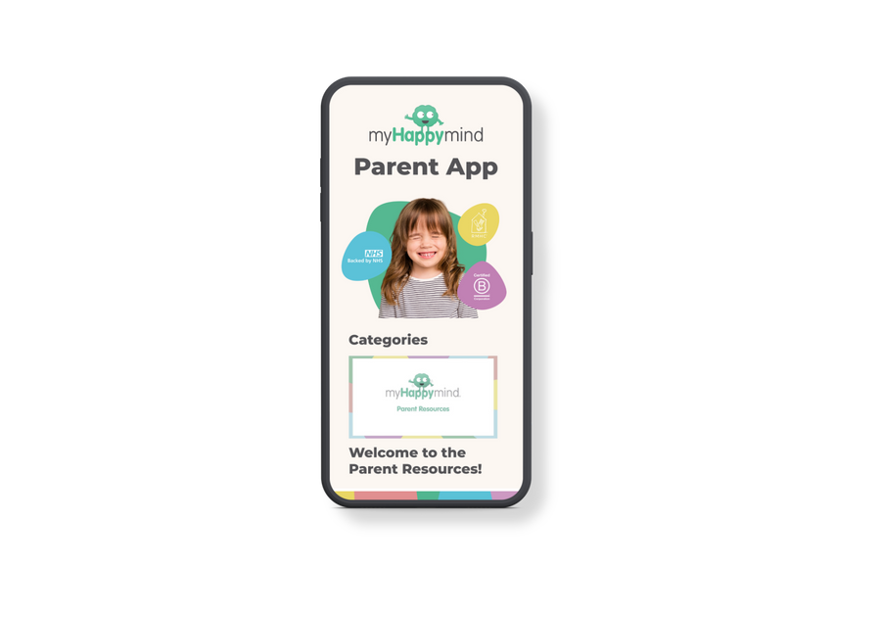
Support your child at home
Log onto the parent app for more information about the Meet Your Brain module and how you can support your child at home.
There are lots of activities you can do together including Happy Breathing and making a Glitter Jar, listening to the story and song, plus much more.
myHappymind for Parents
Educate yourself
Learn all about what your children are learning in school
Exclusively for parents with children at a myHappymind School or Nursery.
To access the materials just go to https://myhappymind.org/parent-resources and enter your name, email and authentication code.
(Please contact your school for your authentication code.)
4

Slide 6



What’s up next...
Celebrate
1

Slide 7
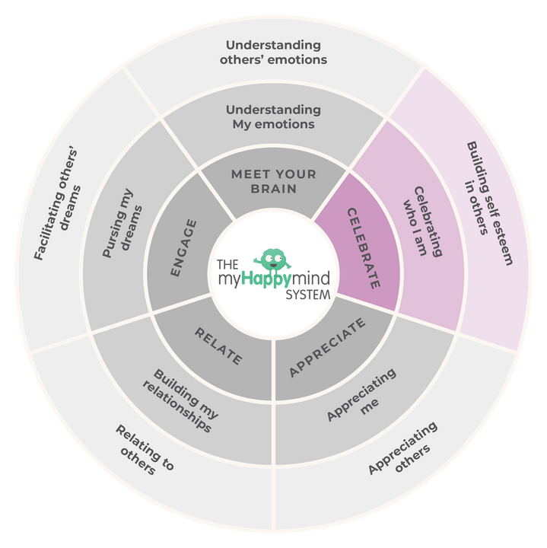
Celebrate
Here we will be learning all about how to Celebrate our character and
who we are.
Support your child at home:
You can sign up to the app here:
https://myhappymind.org/parent-resources
(Please contact your school for your authentication code.)
6

Slide 8


Want to learn more
about the science
of happiness?
MY HAPPY MIND
BY LAURA EARNSHAW
My Happy Mind is the first book by our founder Laura Earnshaw. The book reveals all science-backed secrets used in our curriculum to empower ad educate parents - whether your child is struggling already, or you’re interested in future-proofing their mental health, there’s something in here for everyone.
7

Slide 9
Meet Your Brain
in action
8

Slide 10







Want to hear more
about myHappymind?
Want to share a picture of your myHappymind experience as a parent? We’d love for you to join us over on our social media channels!
myHappymind.org
@myHappymind
@_myHappymind
@myHappymind

